Slide 1
RUNGTA COLLEGE OF DENTAL SCIENCES & RESEARCH
TITLE OF THE TOPIC- FRANKEL APPLIANCE
DEPARTMENT OF ORTHODONTICS AND DENTOFACIAL ORTHOPAEDICS

Slide 2
Specific learning Objectives
CORE AREAS | DOMAIN | CATEGORY
Midline Diastema and it’s etiology and treatment | COGNITIVE | MUST KNOW
PROCLINATION | COGNITIVE | NICE TO KNOW
CROWDING | COGNITIVE | MUST KNOW
SPACING | COGNITIVE | NICE TO KNOW
ROTATION | COGNITIVE | MUST KNOW

Slide 3
Contents
Midline Diastema and it’s etiology and treatment
Proclination
Spacing
Crowding
Spacing
Rotation
Summary

Slide 4
MIDLINE DIASTEMA
REFERS TO ANTERIOR MIDLINE SPACING BTW THE TWO MAXILLARY CENTRAL INCISOR
Can be result of a no.Of causes :
Transient malocclusion
Tooth material arch length discrepancy
Unerupted mesiodens
Abnormal frenal attachment
Proclination
Midline pathology
Iatrogenic

Slide 5
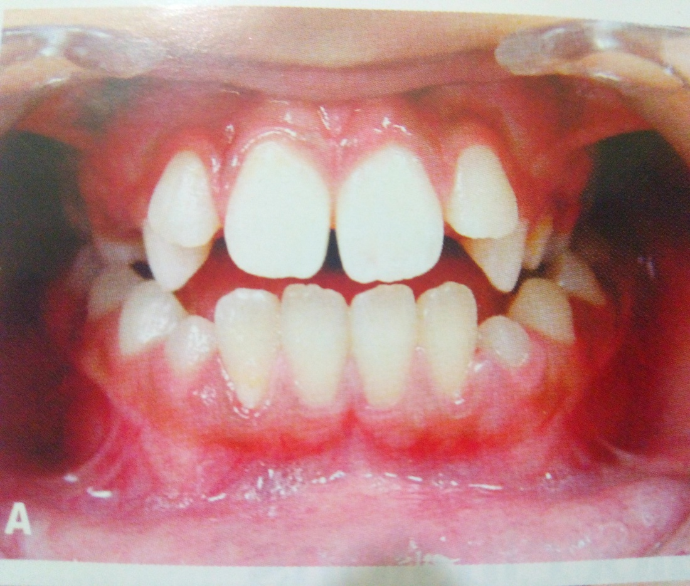
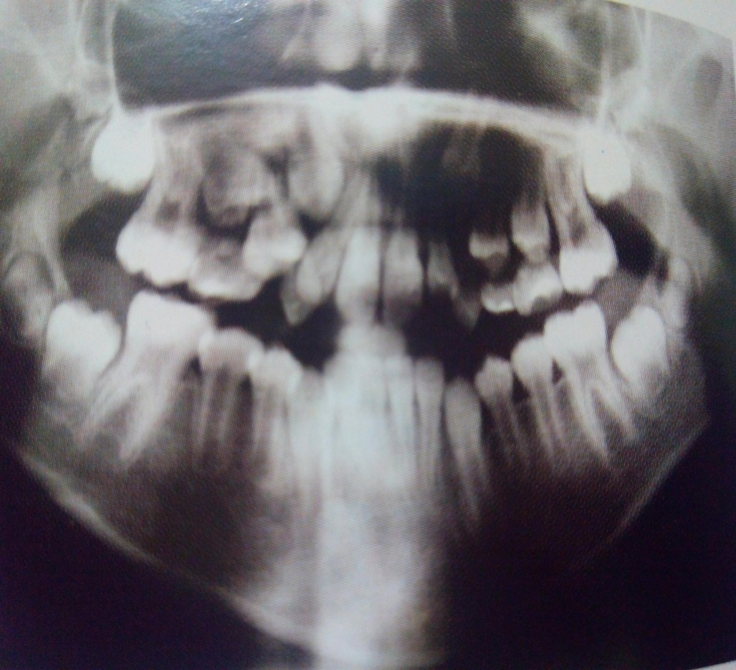
TRANSIENT MALOCCLUSION
Midline spacing can occur during the mixed dentition period associated with the eruption of the permanent canines.This stage called the ugly duckling stage corrects itself as the developing permanent canine erupts

Slide 6
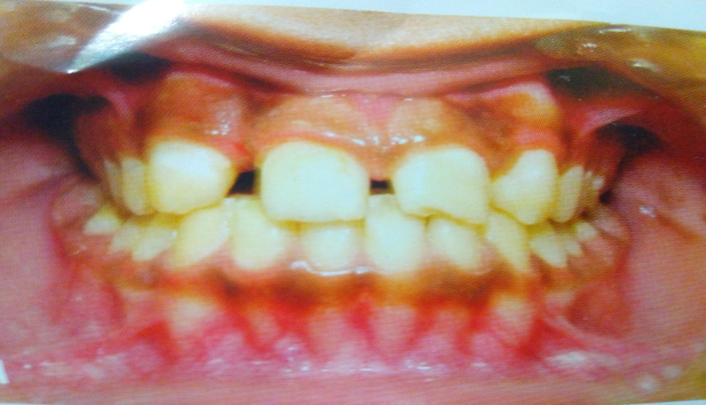
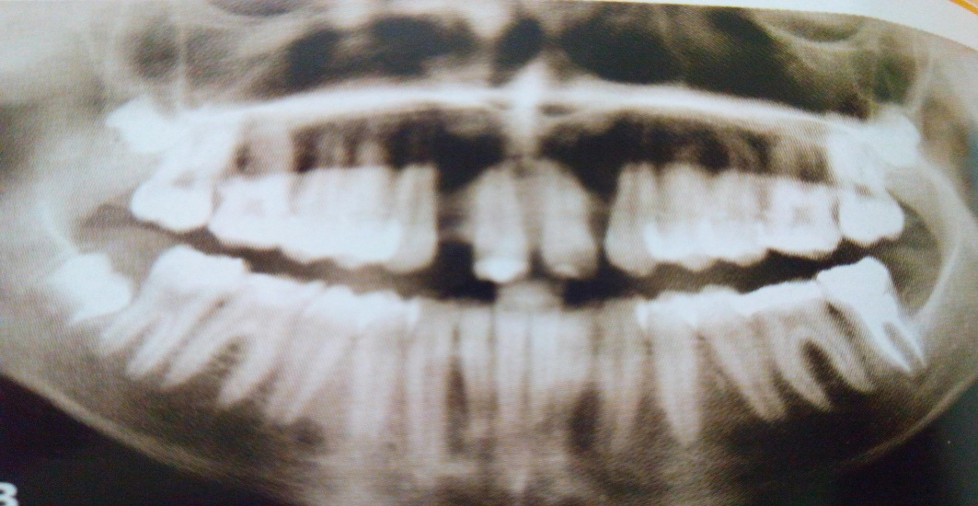
TOOTH MATERIAL ARCH LENGTH DISCREPANCY
Condition’s such as missing teeth, microdontia, peg shaped laterals, macrognathia and extractions with resultant drifting of adjacent teeth

Slide 7
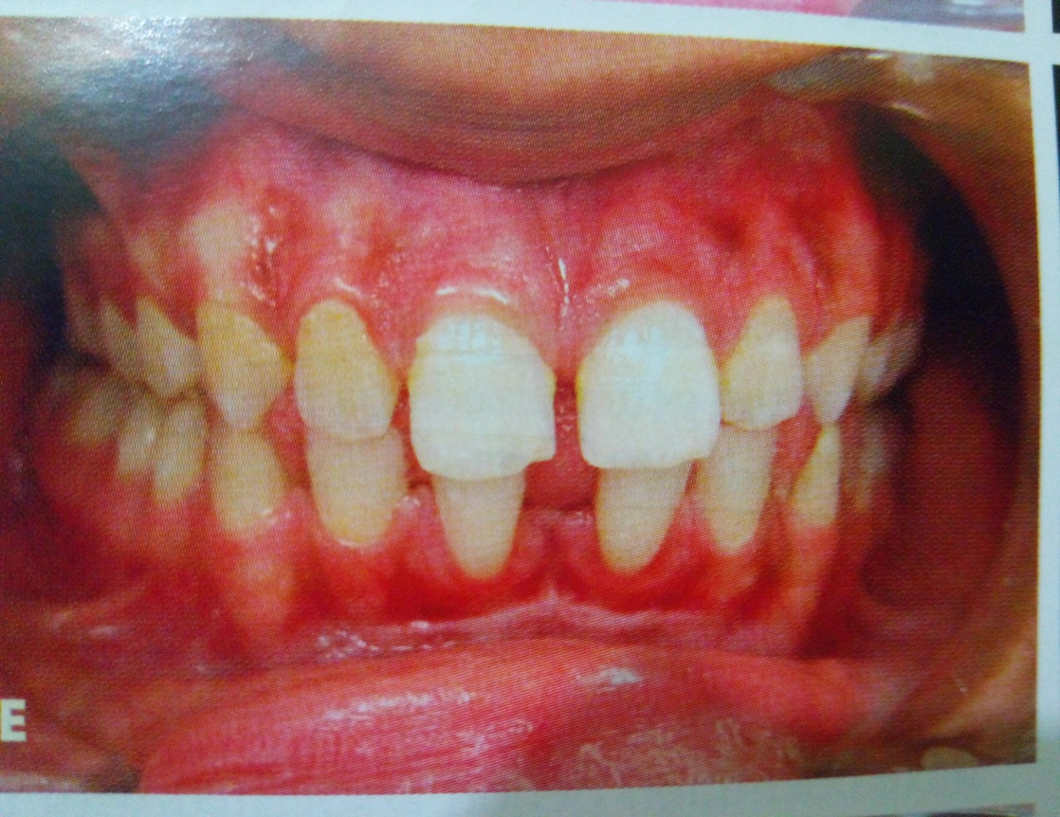
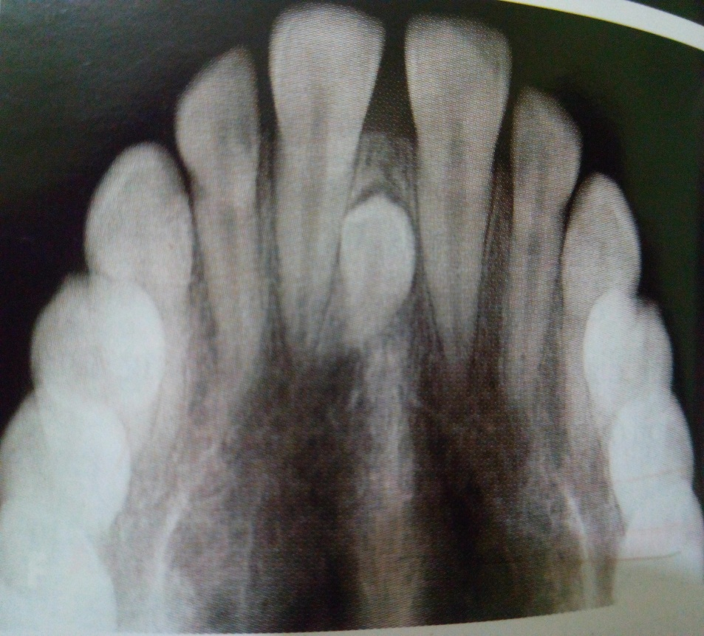
UNERUPTED MESIODENS
Presence of an unerupted mesiodens btw the two central incisors also predispose to midline diastema

Slide 8
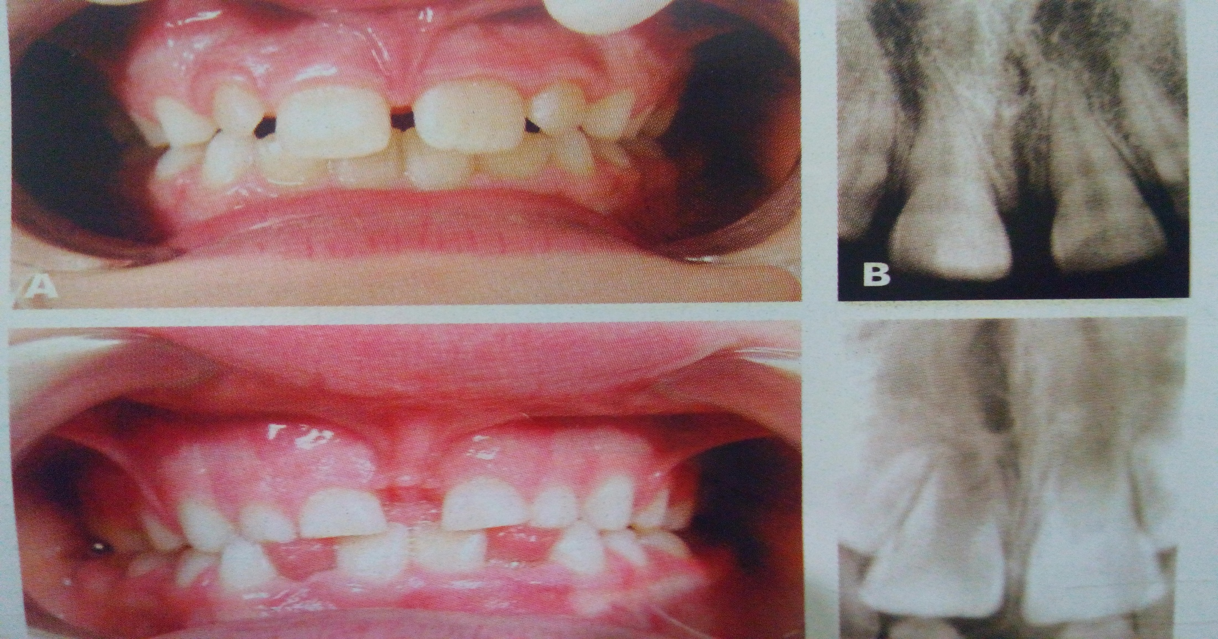
ABNORMAL FRENAL ATTACHMENT
Presence of thick and fleshy frenum

Slide 9
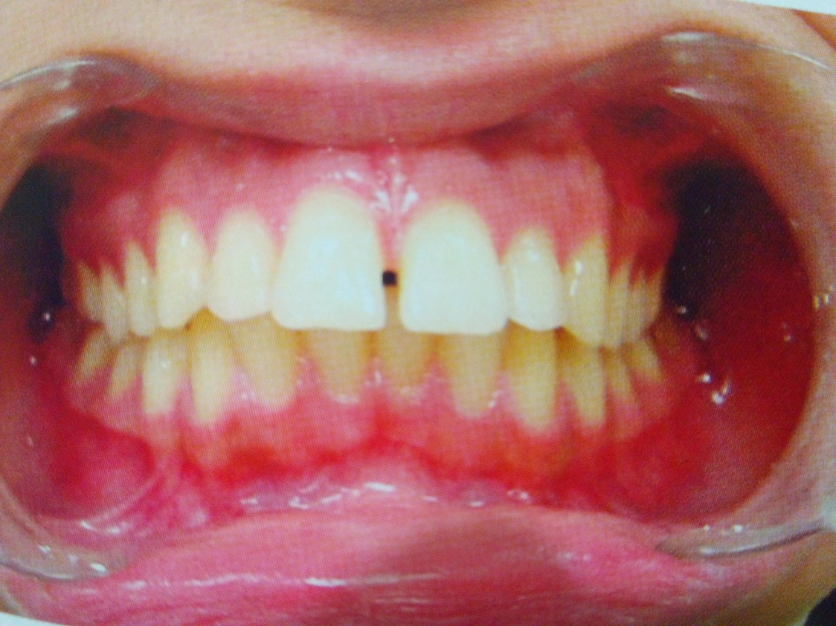
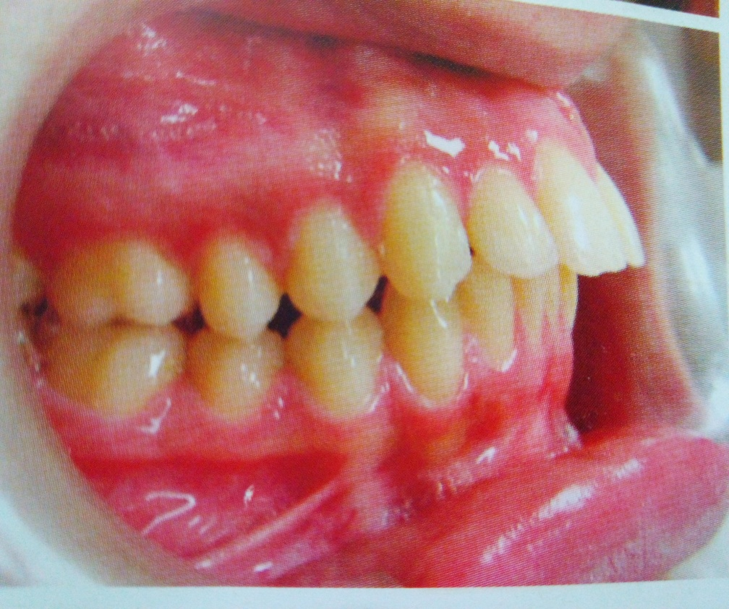
PROCLINATION
Proclination of teeth as a result of habits such as thumb sucking or tongue thrusting can cause midline diastema along with generalized space.

Slide 10
MIDLINE PATHOLOY
Soft tissue and hard tissue pathology such as cyst’s,tumour and odontomes may cause midline diastema

Slide 11
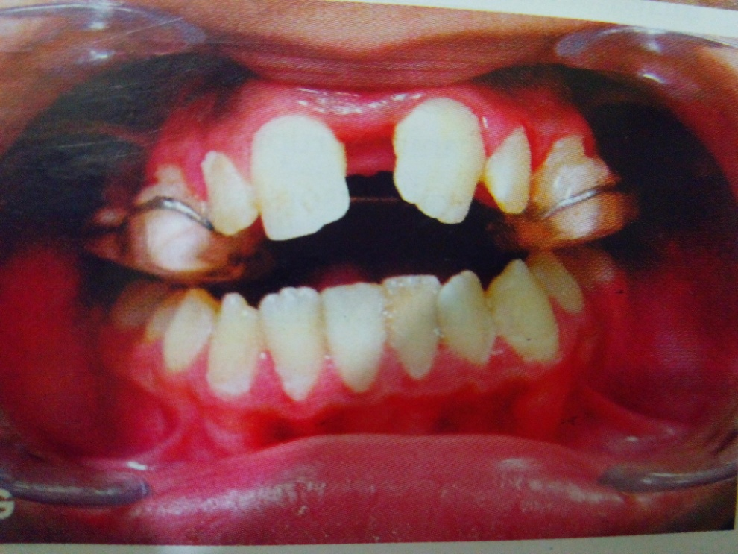
IATROGENIC
Midline diastema can occur when certain therapeutic procedures such as rapid maxillary expansion are undertaken

Slide 12
DIAGNOSTIC ASPECTS
Proper history and clinical examination
Blanch test is performed to diagnose a fleshy labial frenum
Midline radiographs are valuable aids in diagnosing midline pathology
Tooth material arch length discrepancy can be determined using model analysis

Slide 13
TREATMENT
It is done in three phases:
Removal of cause
Active treatment
Retention

Slide 14
FIRST PHASE
Habits should be eliminated using fixed and removable habit breakers
Unerupted mesiodens should be extracted
Frenectomy should be performed

Slide 15
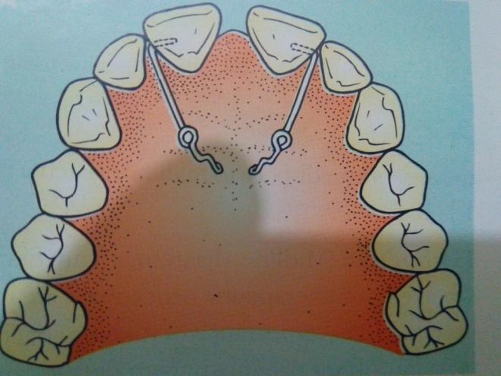
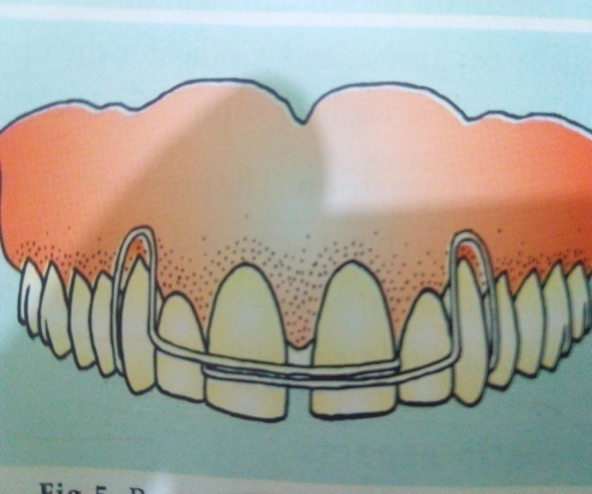
SECOND PHASE
Done using removable appliances or fixed appliances
Removable appliance:
Finger springs
Split labial bow

Slide 16
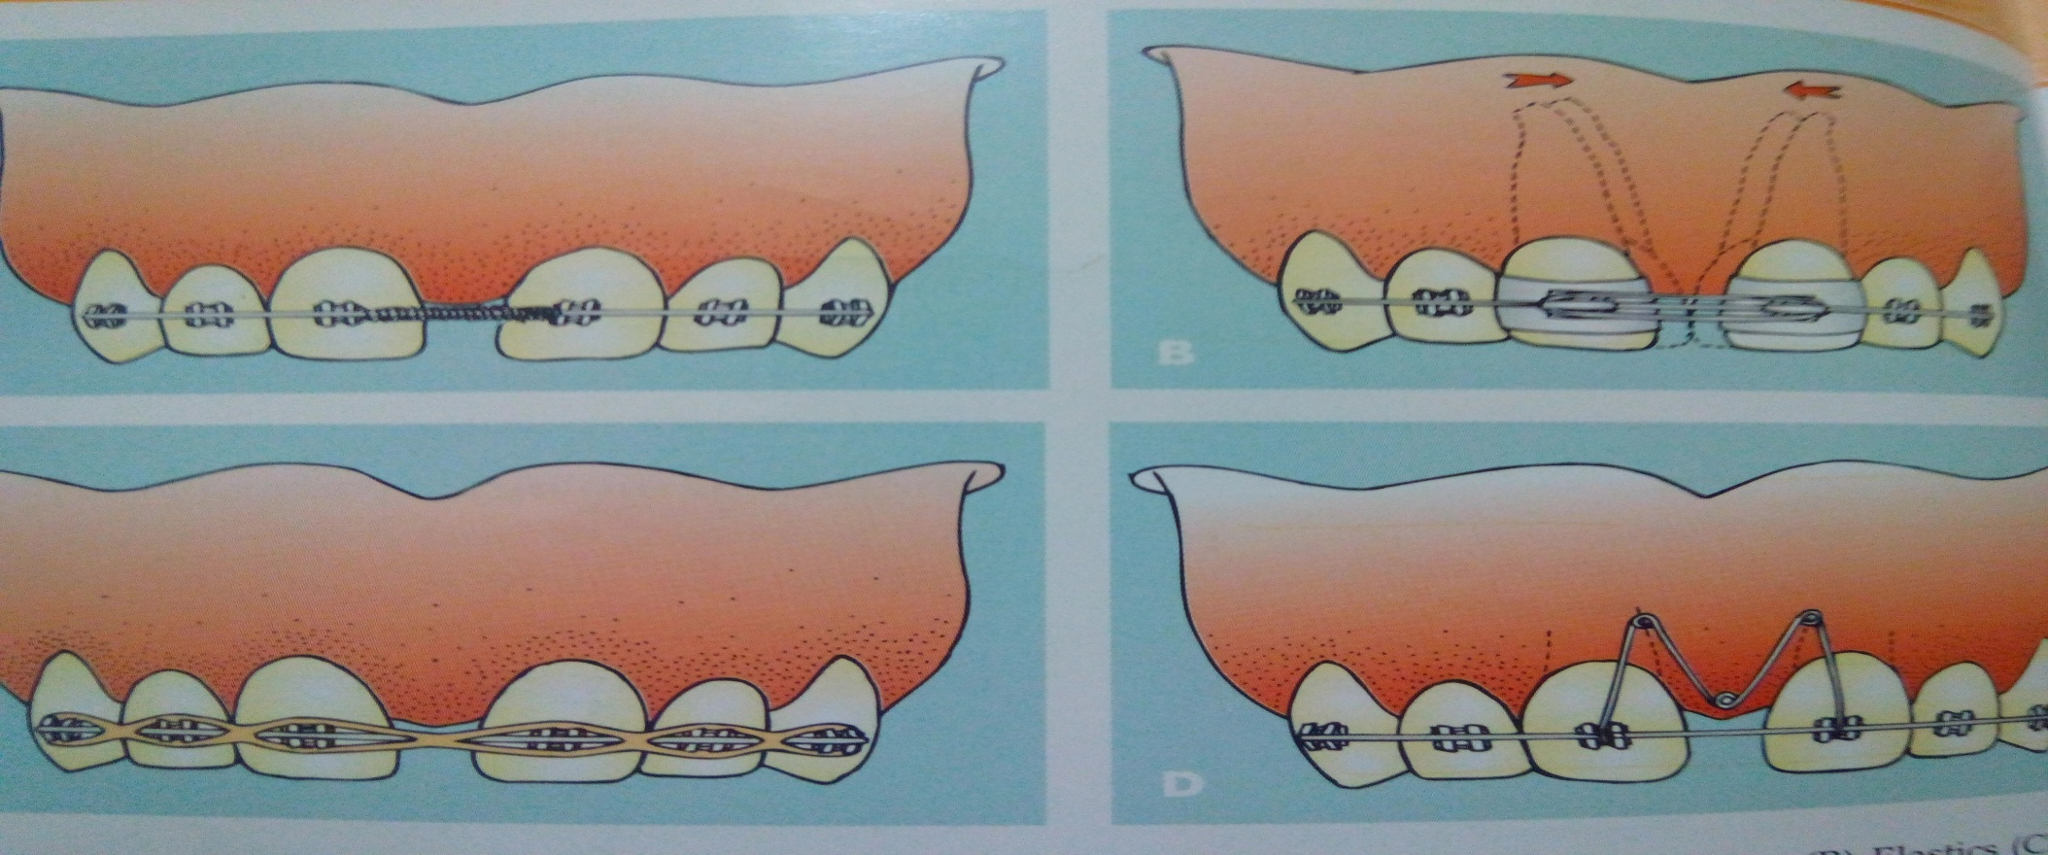
Fixed appliance:
Elastics
Springs

Slide 17
THIRD PHASE
It involves retaining the treated malocclusion
Since prolonged retention is indicated it is advisable to use lingual bonded retainers
Other retainers:
Banded retainers
Hawleys retainers

Slide 18
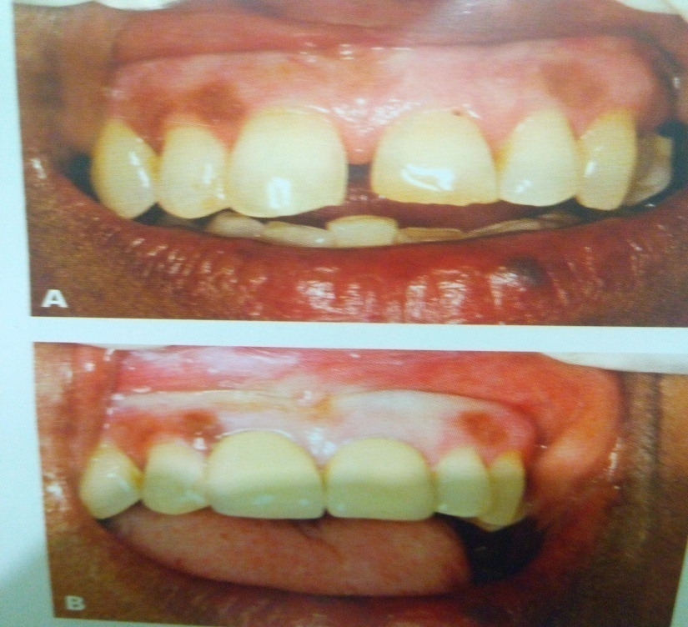
ROLE OF COSMETIC RESTORATION & PROSTHESIS/CROWN
Esthetic composite resins are generally used to close midline diastema
Teeth with other anomalies of shape and size require prosthetic rehabilitation
Crowns on central incisor can close midline diastema

Slide 19
SPACING
Commnly seen menifestation of class I malocclusion
Is a normal features in deciduous dentition and is considered as a positive prognostic sign
In permanent dentitin spacing is abnormal

Slide 20
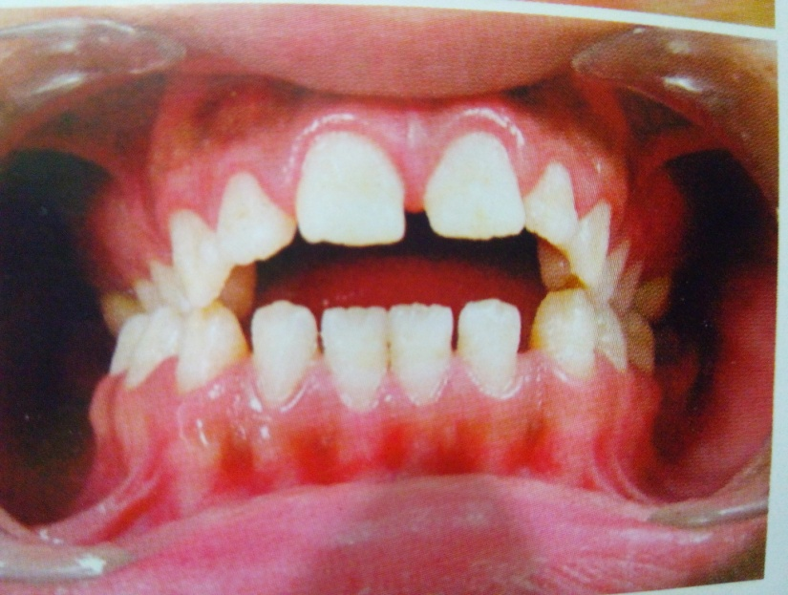
ETIOLOGY
Generalized spacing occur as aresult of disproportion btw arch length and tooth material.Condition such as oligodontia and microdontia
Can occur as a result of alteration in tooth morphology. Ex-peg shaped laterals
Deletarious oral habits .ex thumb sucking & tongue thrusting

Slide 21
Presence of an abnormally large tongue
Unerupted supernumerary teeth or other pathology & cystic lesions
Premature loss of permanent teeth

Slide 22
DIAGNOSIS
Model analysis
Radiographic examination

Slide 23
TREATEMENT
Removal of the etiology
Use of removal & fixed appliances:
Removal appliance-active removable appliance incorporating labial bow
Fixed appliance-fixed appliance with elastic chain or elastic threads
Use of crown & prosthesis

Slide 24
CROWDING
Another common menifestation of classI malocclusion
Occurs as a result of disproportion btw tooth size & arch length
Relative decrease in arch length or an increase in tooth material can result in crowding

Slide 25
ETIOLOGY
Arch length-tooth material discrepancy
Presence of supernumerary or extracted tooth
Presence of an over retained deciduous tooth along with its permanent counter part

Slide 26
Abnormality in size and shape of teth
Premature loss of deciduous tooth result in drifting of adjacent teeth into extraction space. Example-early loss of second deciduous molar
Late lower labial segment crowding occurs in mid to late teens

Slide 27
CAUSES OF LATE LOWER INCISOR CROWDING
Late mandibular growth
Reduction of inter canine width
Gingival fibres and occlusal forces
Lack of approximal attrition
Role of mandibular third molar

Slide 28
DIAGNOSIS
Model analysis
Possible causes of crowding should be determined

Slide 29
TREATMENT
Minor crowding resolves spontaneously during transition from deciduous to the mixed dentition phase
Use of leeway space in children who exibit moderate incisal crowding during mixed dentition
Children exibiting severe crowding may ned the extraction of some teeth & therefore may be assesed for serial extraction

Slide 30
GAINING SPACE
VARIOUS MATHOD OF GAINING SPACE:
Proximal stripping
Expansion
Extraction
Molar distalization
Derotation & uprighting of posterior teeth

Slide 31
REMOVABLE APPLIANCE
Removable appliance that incorporates:
Springs
Canine retractors
Labial bows

Slide 32
FIXED APPLIANCES
Offer better control in crowding
Fixed appliance that may use of:
Multilooped arch wire
Resilient nickel-titanium wires
Open coil springs

Slide 33
ROTATION
ARE TOOTH MOVEMENTS THAT OCCUR AROUND THEIR LONG AXES
TWO TYPES OF ROTATION:
MISIO-LINGUAL OR DISTO-BUCCAL
DISTO-LINGUAL OR MESIO-BUCCAL

Slide 34
TREATMENT
SPACE MANAGEMENT
USE OF REMOVABLE APPLIANCE:
MILD ROTATION TREATED USING REMOVABLE APPLIANCE INCORPORATING DOUBLE CANTILEVER SPRING(Z SPRING) ALONG WITH LABIAL BOW
USE OF FIXED APPLIANCES:
ROTATION WEDGES
MILD ROTATION TREATED BY USING RESILIENT ARCH WIRES & ENGAGING THE WIRE INTO THE BRACKET SLOT
ELASTIC THREAD USED TO DEROTATE PREMOLARS IT IS ATTACHED TO LINGUAL ATTACHMENT AND WRAPPED AROUND TOOTH AND TIED TO ARCH WIRE
ACOUPLE USED BY ENGAGING ELASTIC THRED BOTH BUCALLY AND LINGUALLY

Slide 37
Summary
There are different types of malocclusion which should be treated as soon as one gets to know about it because various sequelae associated to it. There are some common malocclusions, midline Diastema, spacing, crowding , rotation, proclination, etc,. With such various malocclusions comes various treartment modalities and the time at which the treatment is undergoing, as it affects the prognosis and time duration of the treatment plan.

Slide 38
REFERENCES
Textbook of Orthodontics – Gurkeerat Singh, Jaypee Brothers; 2nd Edition
Orthodontics – The Art and Science, S.I Bhalajhi, AryaMedi Publishing; 7th Edition
Textbook of Orthodontics – Sridhar Premkumar, Elsevier; 1st Edition
Orthodontics: Diagnosis and Management of Malocclusion and Dentofacial Deformities – O.P Kharbanda, Elsevier; 1st Edition

Slide 39
Question & Answer Session

